Slide 1
The Idiom Flash
You and a partner are to watch these slides and record what you think each idiom means. It will go quickly, so think FAST!

Slide 2
#1
              We’re in hot water.

Slide 3

#2
Drop me a line.

Slide 4

#3
She gave him
a dirty look.

Slide 5
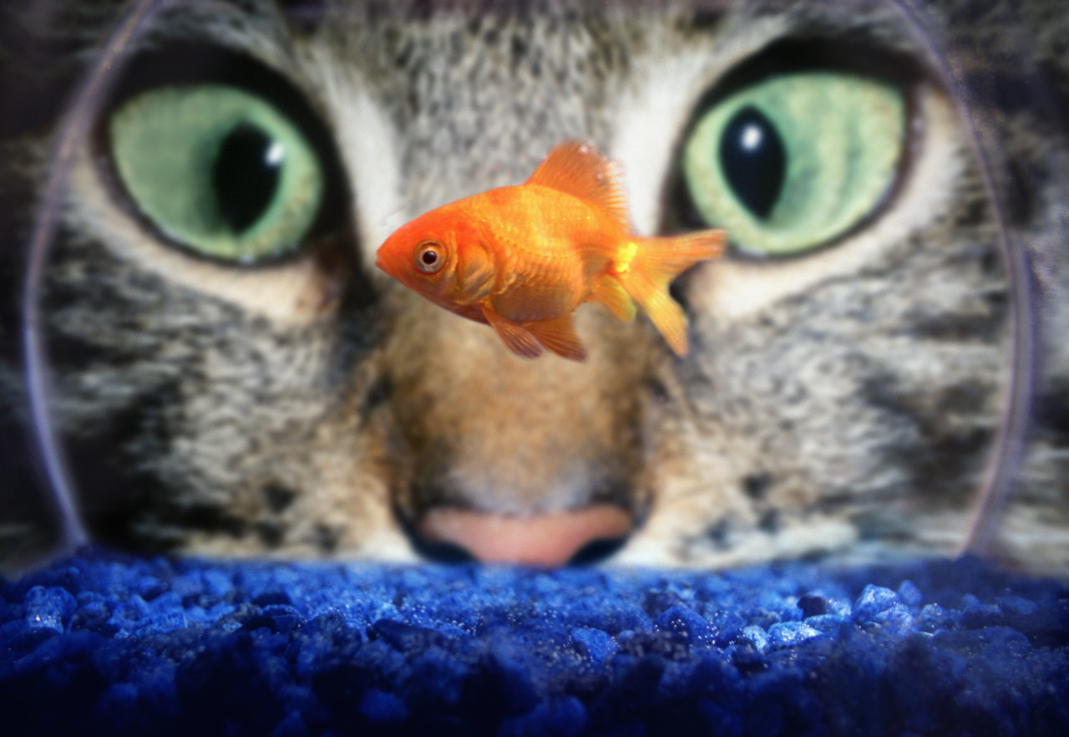
#4
We don’t see eye to eye.

Slide 6

#5
We’re all in the same boat.

Slide 7
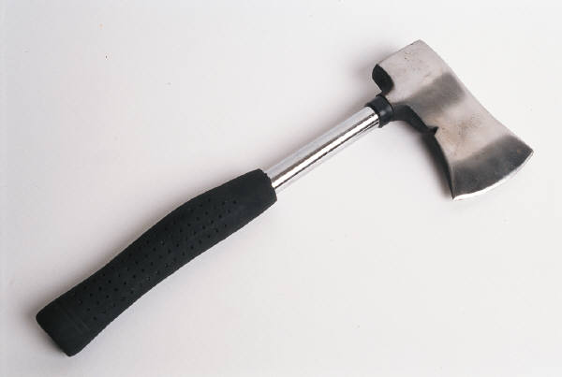
#6
The boss just gave him the ax.

Slide 8
#7
You really put your foot in your mouth.

Slide 9

#8
The judge threw the
book at her.

Slide 10
#9
I’m hung up on this problem.

Slide 11

#10
It’s in the bag.

Slide 12
#11
I’m stumped.

Slide 13
#12
He passed the test by the skin of his teeth.

Slide 14

#13
She let the cat out of the bag.

Slide 15
#14
You can’t pull the wool over his eyes.

Slide 16
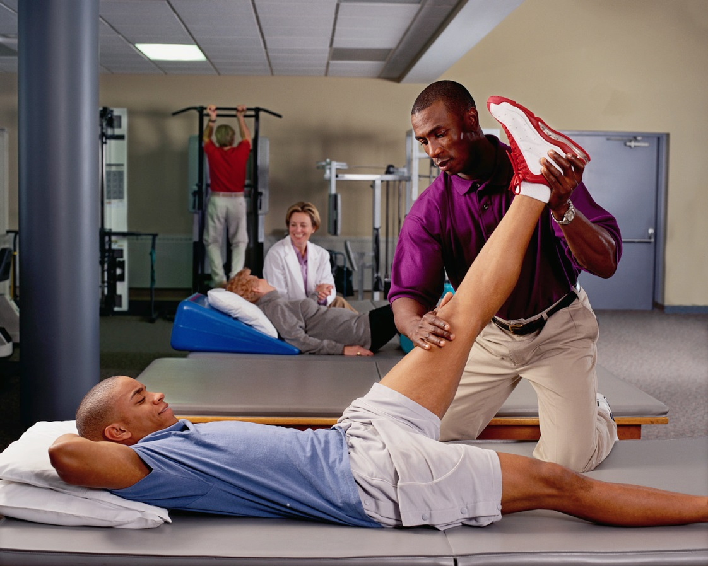
#15
He gave me the leg up.

Slide 17

#16
Give me a hand with this assignment.

Slide 18

#17
She’s full of herself.

Slide 19
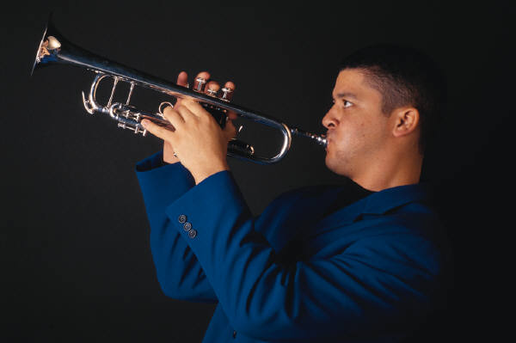
#18
Let’s face the music.

Slide 20
#19
The story really got to me.

Slide 21

#20
This car can stop on a dime.

